Slide 1
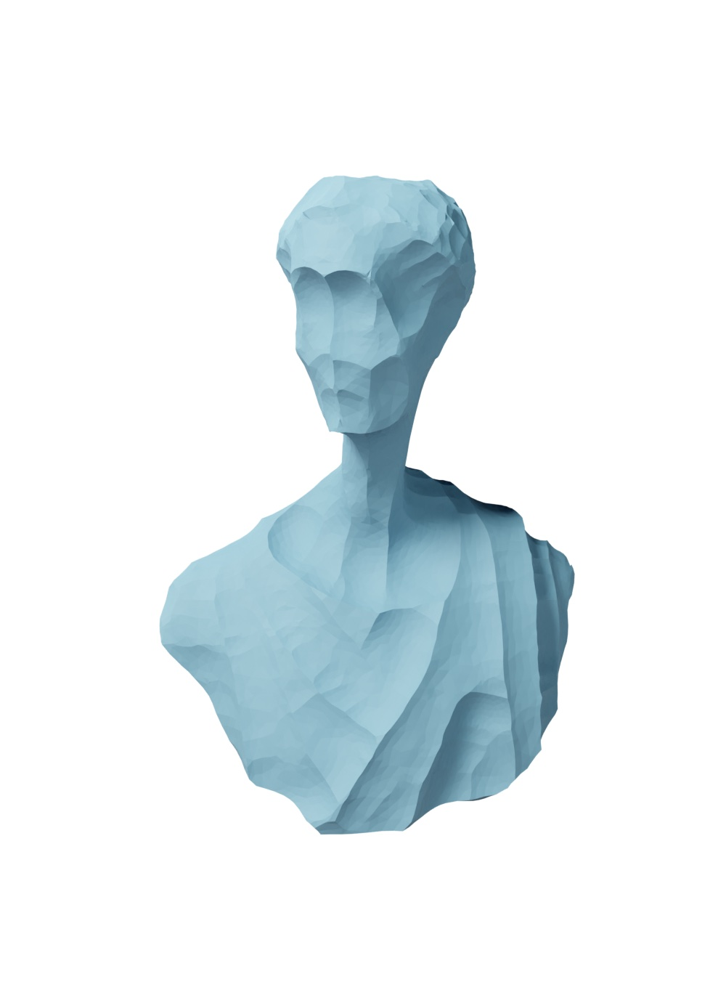
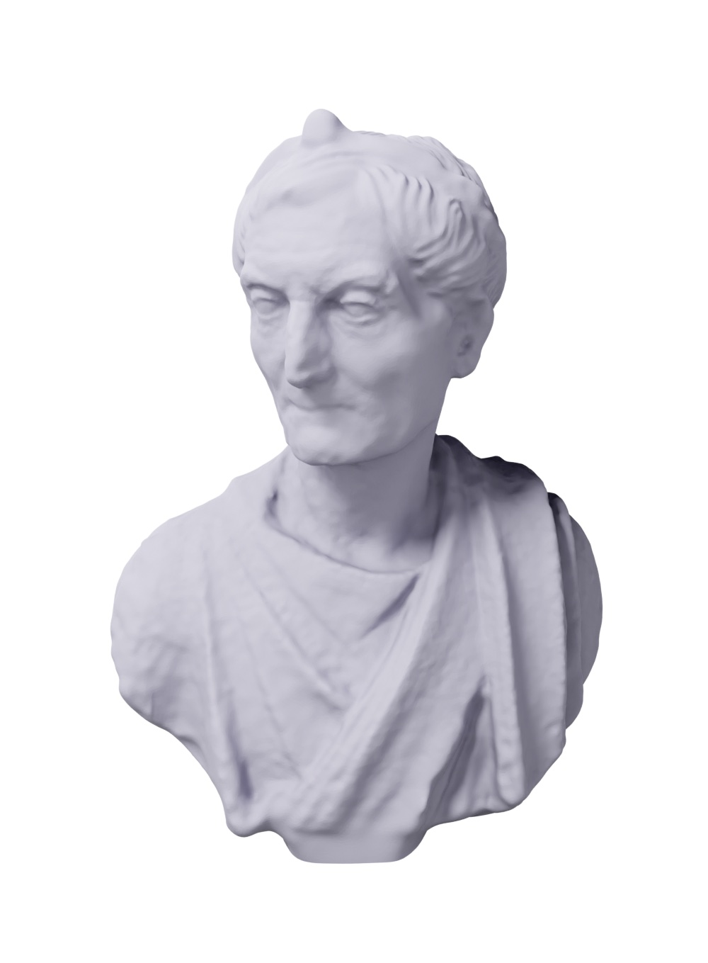
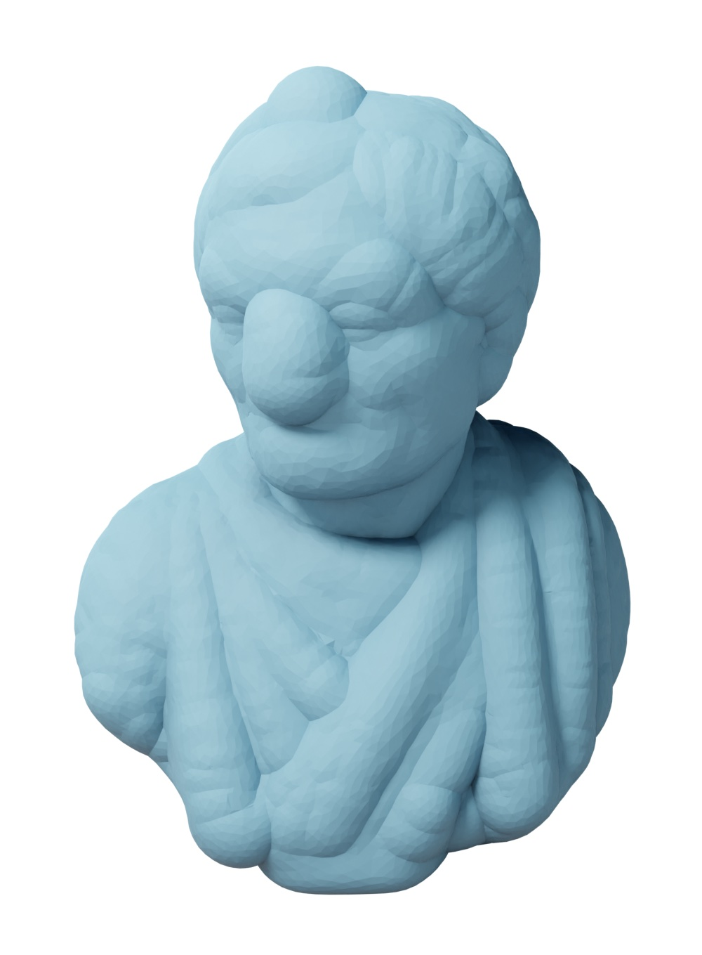
Feature-Preserving Offset Mesh Generation from Topology-Adapted Octrees
Daniel Zint, Nissim Maruani, Mael Rouxel-Labbé, Pierre Alliez
-5%
+5%
Notes:
Used in:
Robotics: path planning
Fluid dynamics
Milling

Slide 2
Minkowski Sum

Slide 3
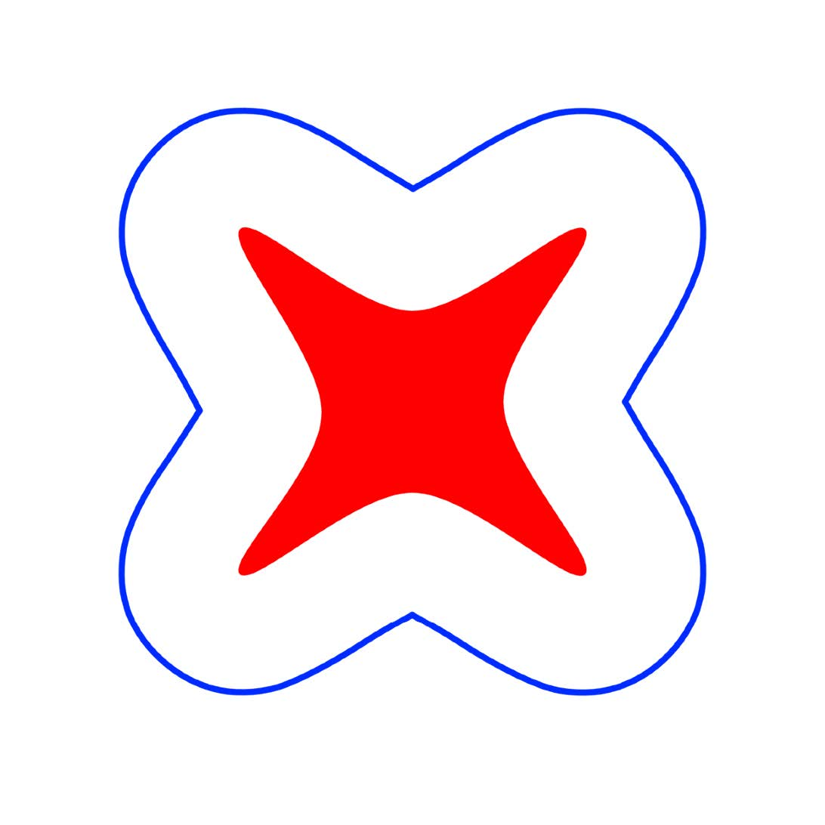


Offset Examples 2D

Slide 4
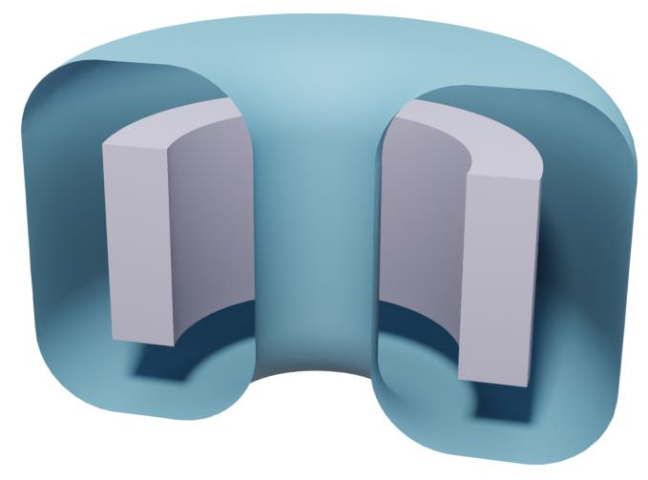
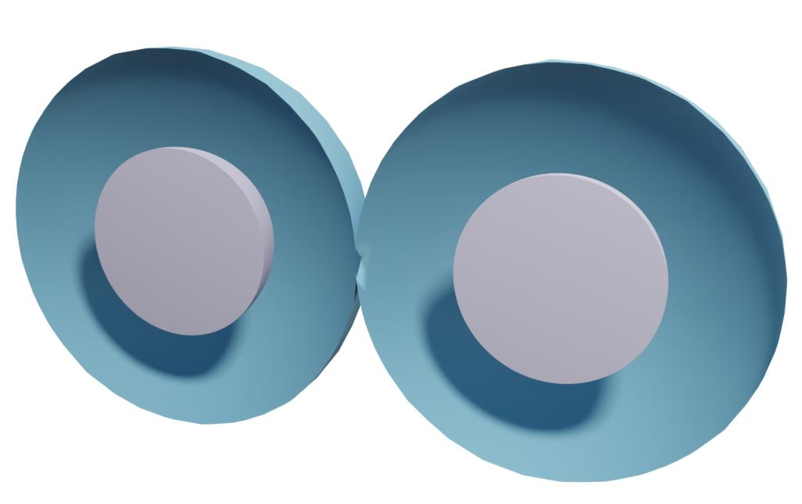
Offset Examples 3D

Slide 5
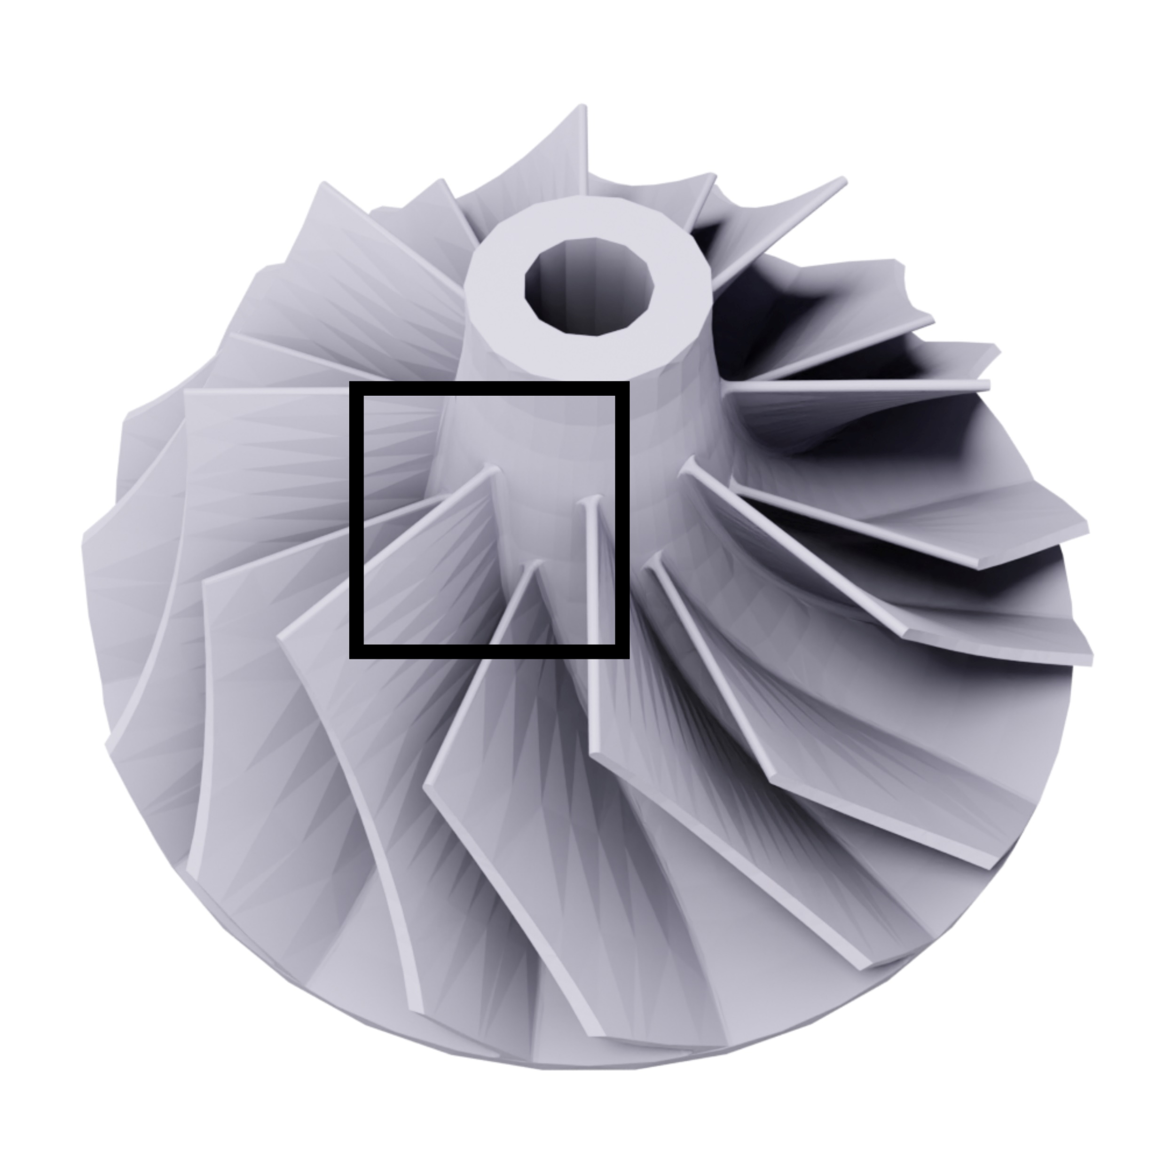
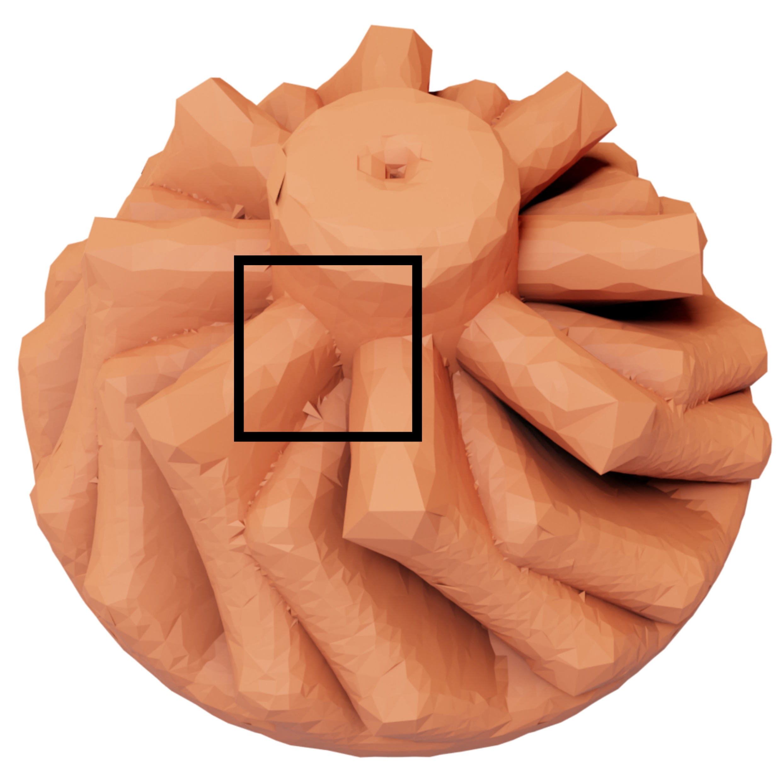
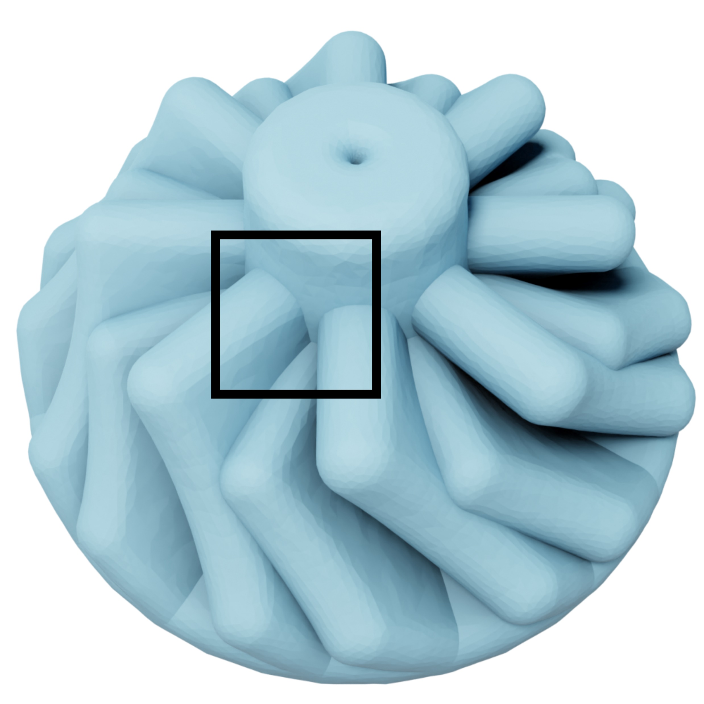
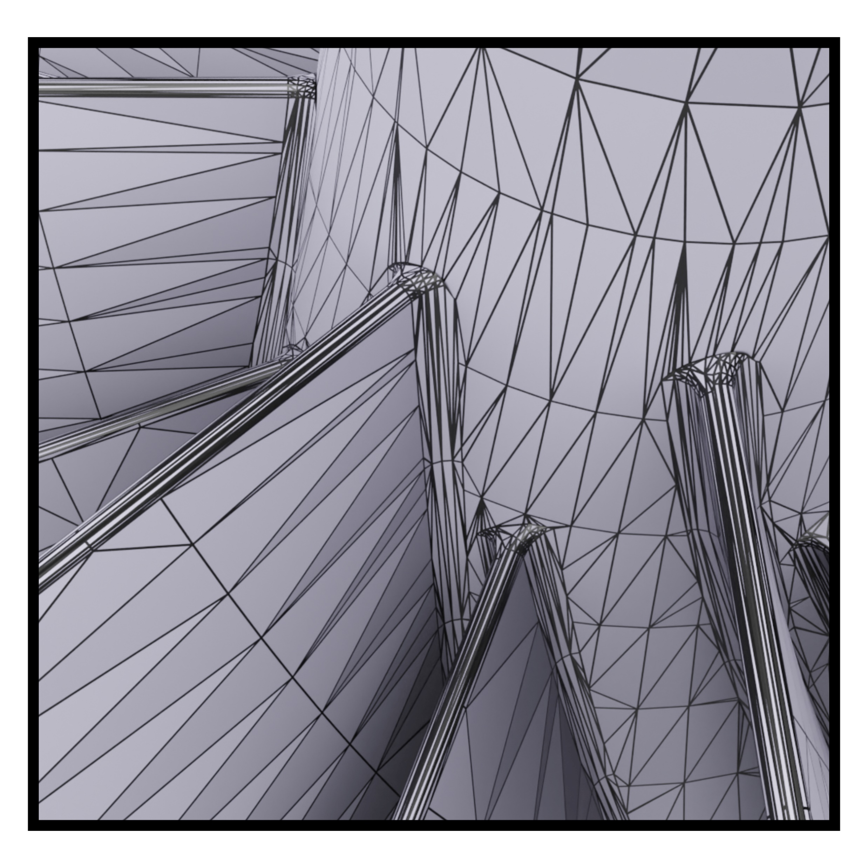
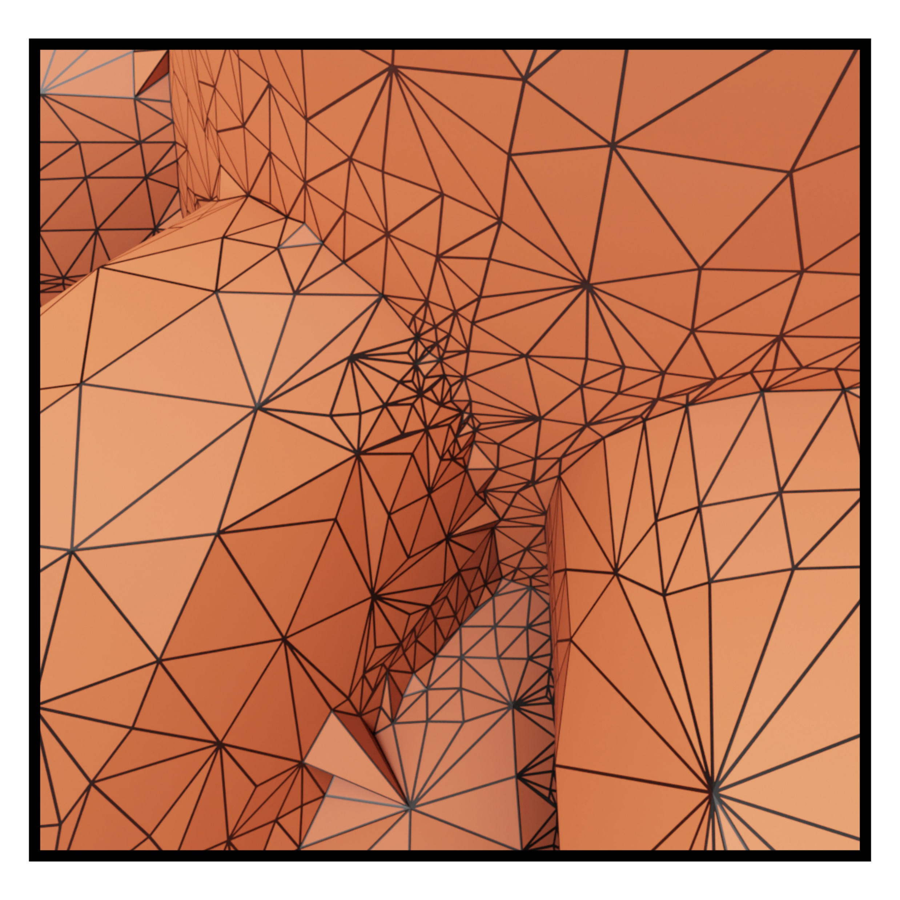
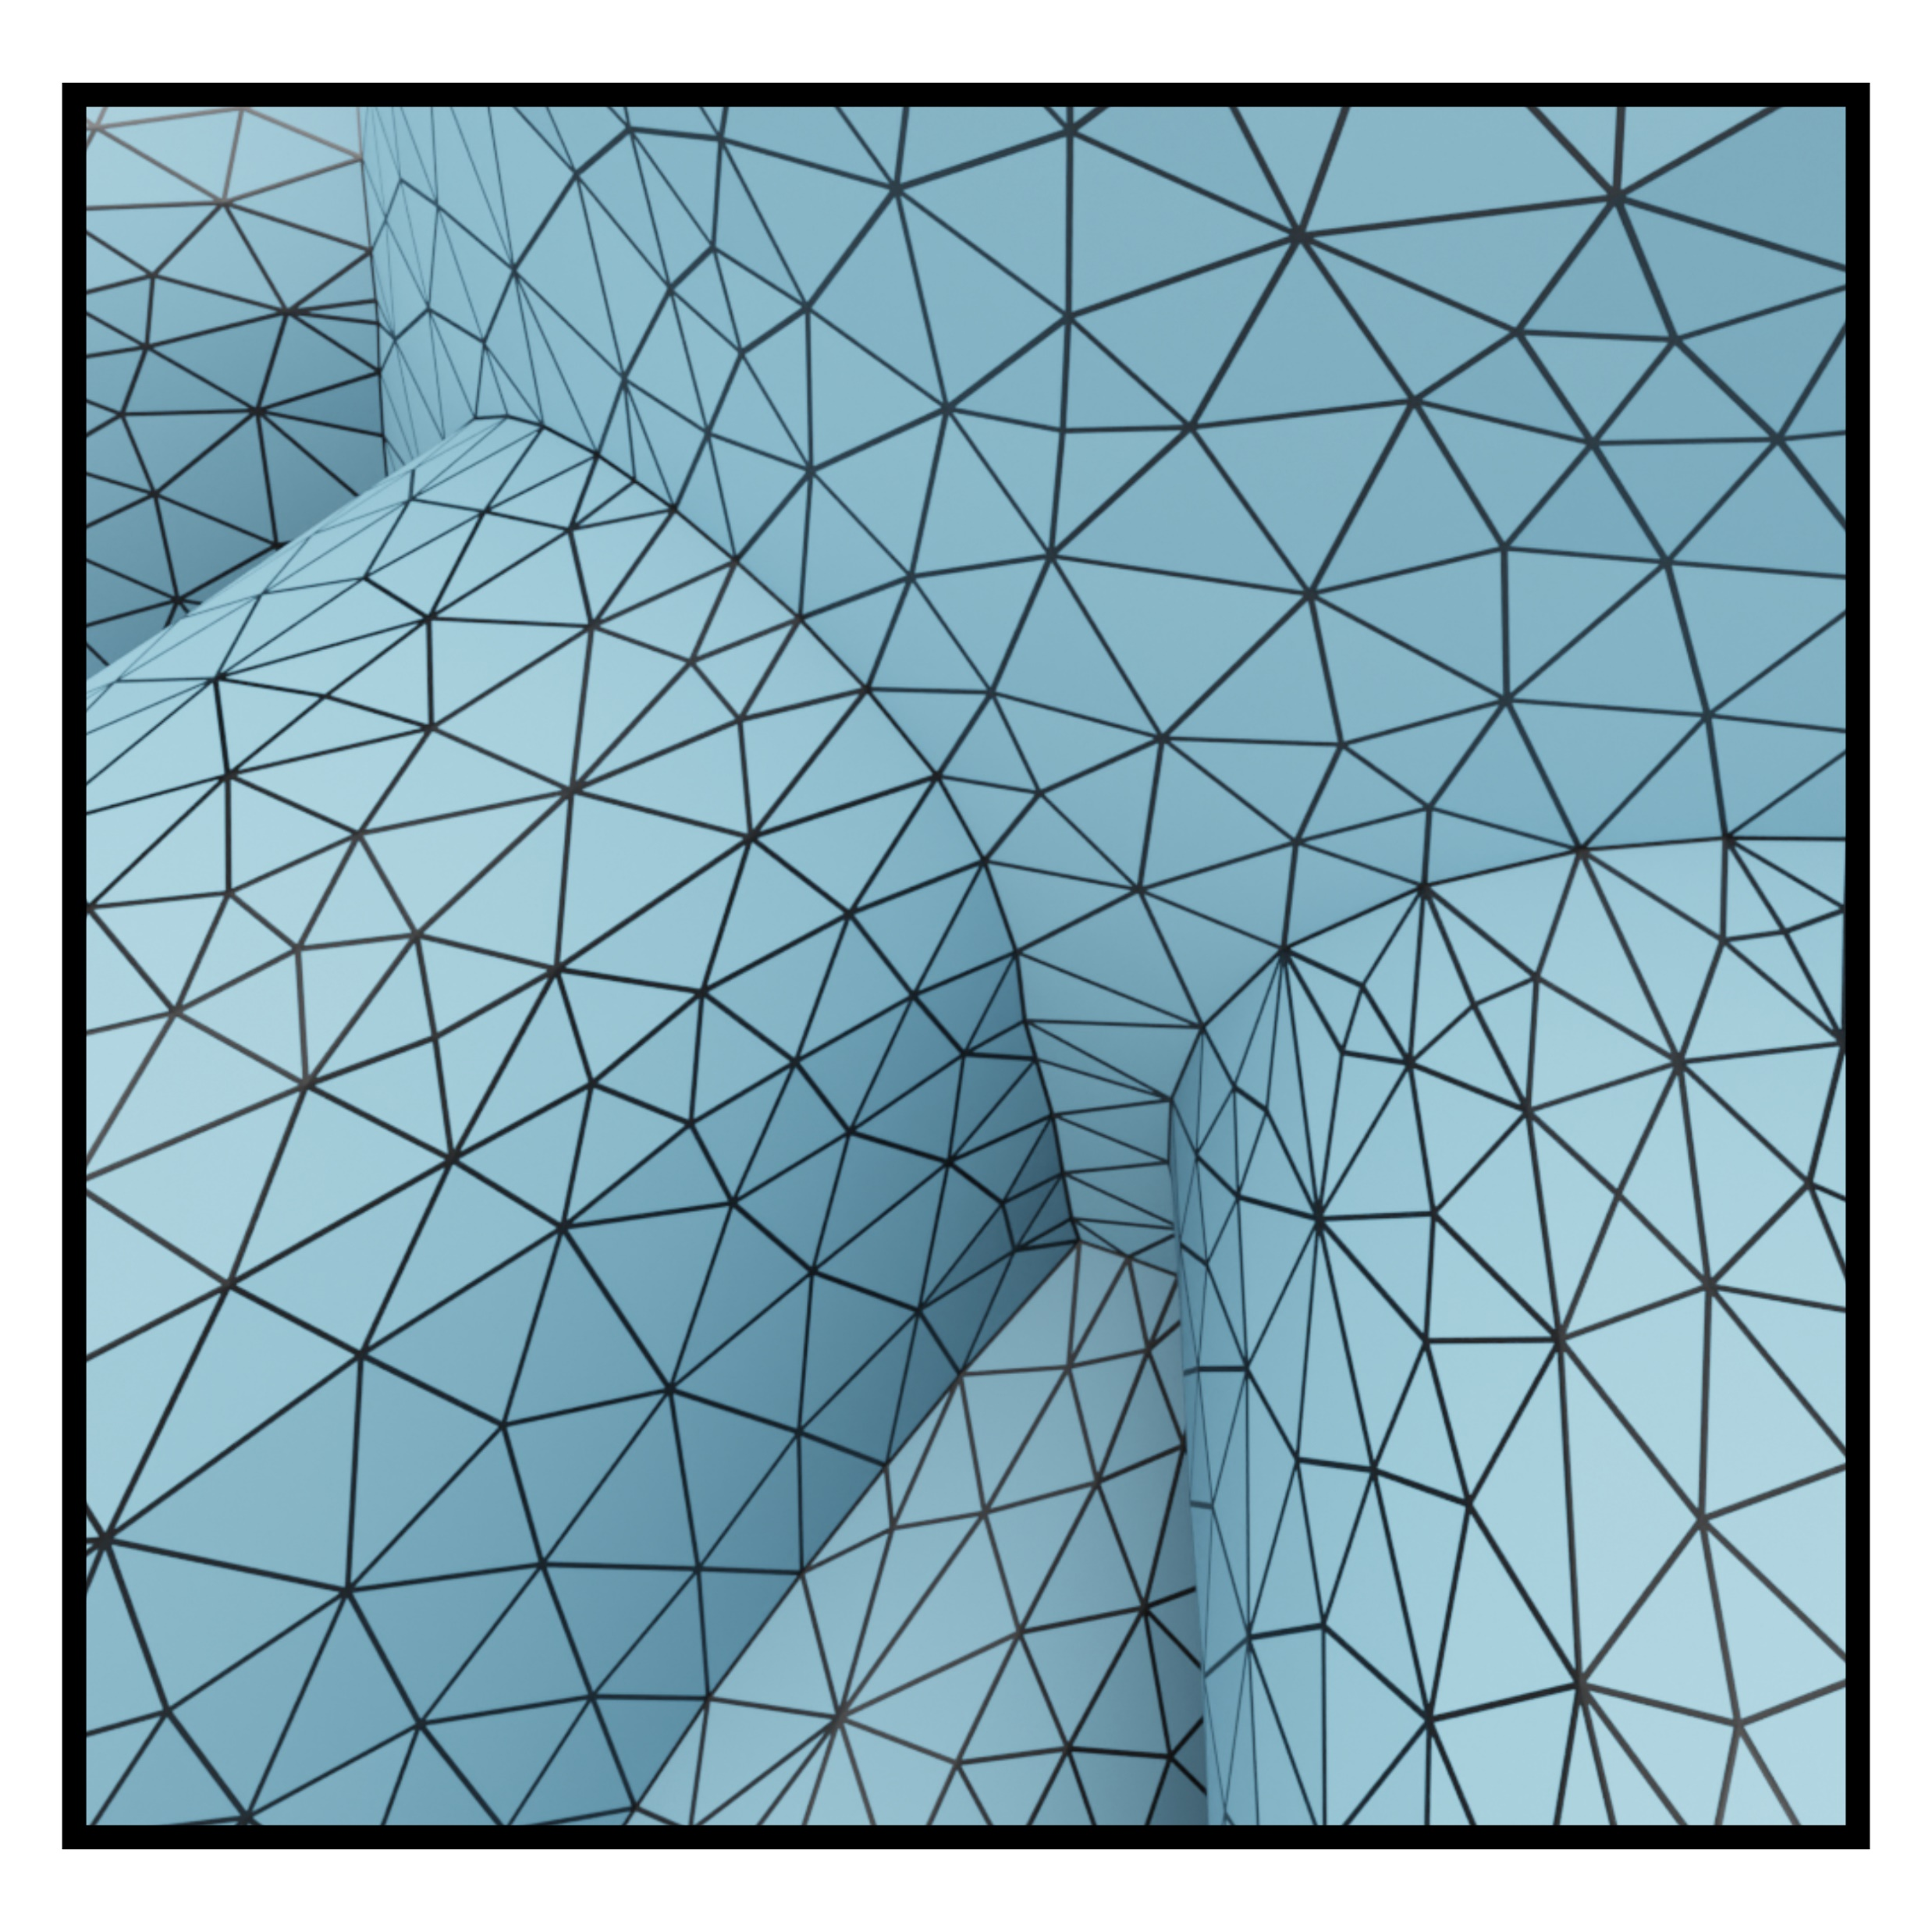
Overview
Input
Dual Contouring
Remeshing

Slide 6
Dual Contouring

Slide 7
Dual Contouring

Slide 8
Dual Contouring

Slide 9
Dual Contouring

Slide 10
Dual Contouring

Slide 11
Dual Contouring

Slide 12
Dual Contouring

Slide 13
Dual Contouring

Slide 14
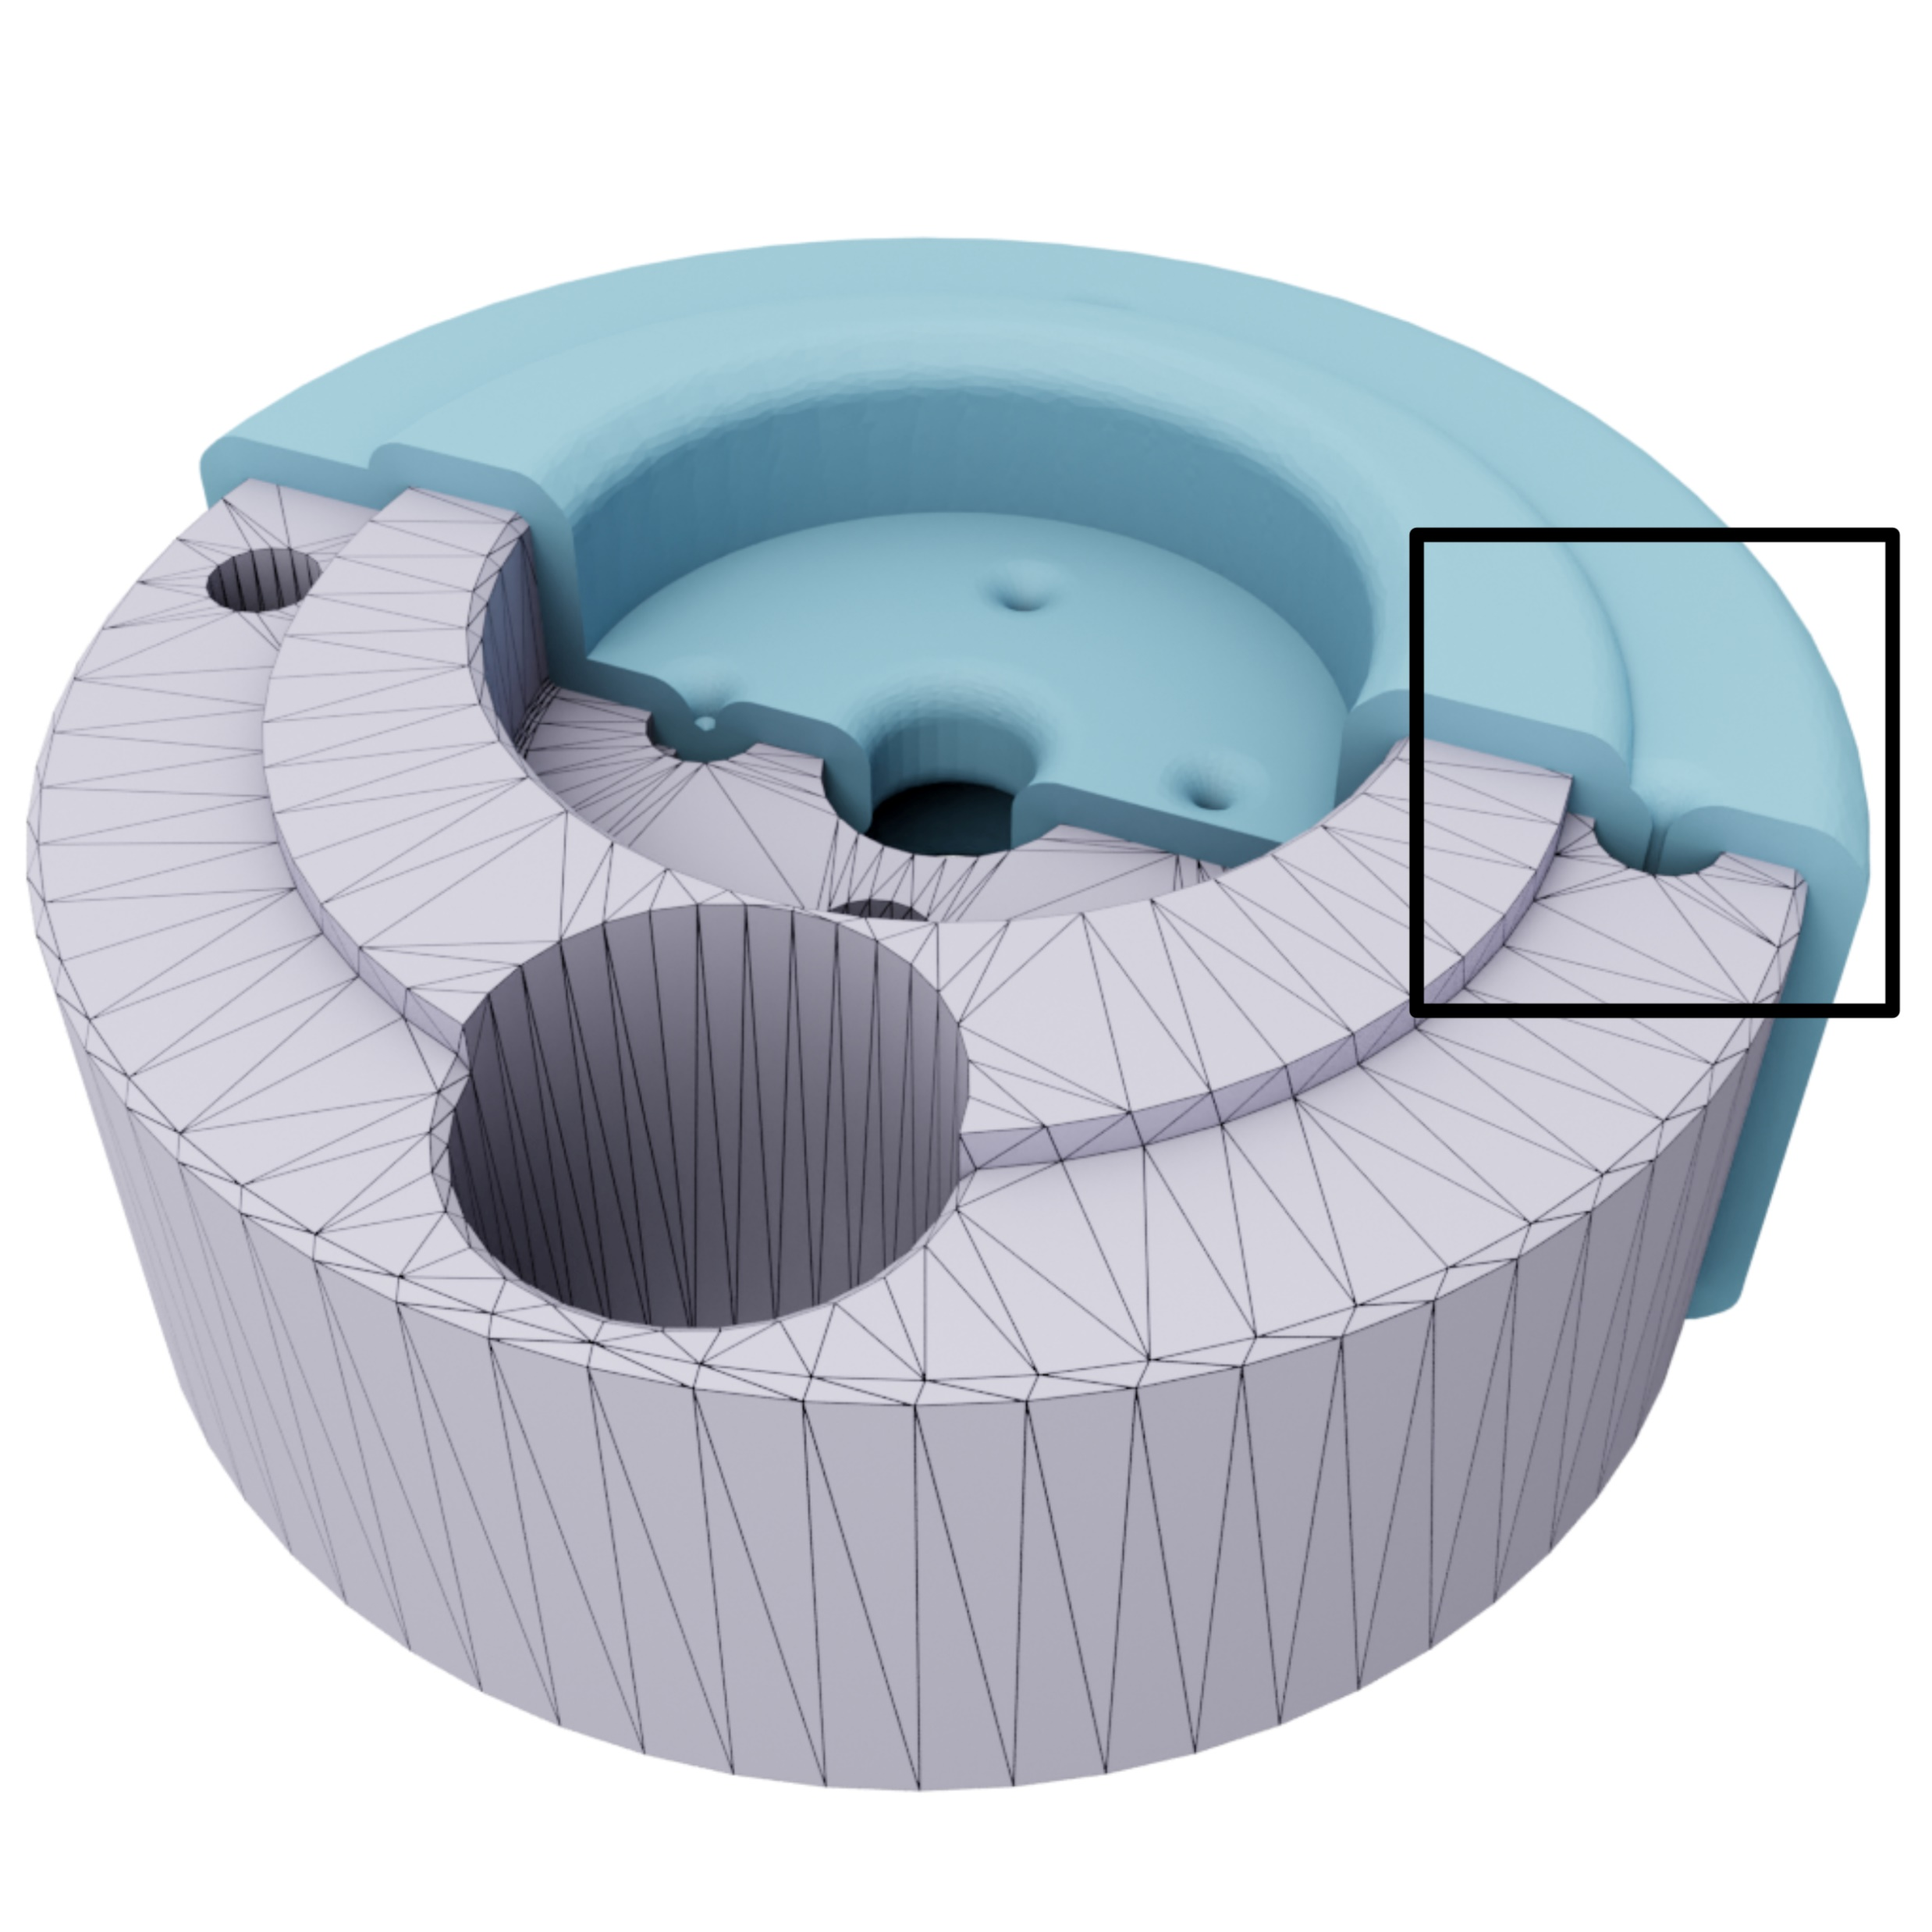
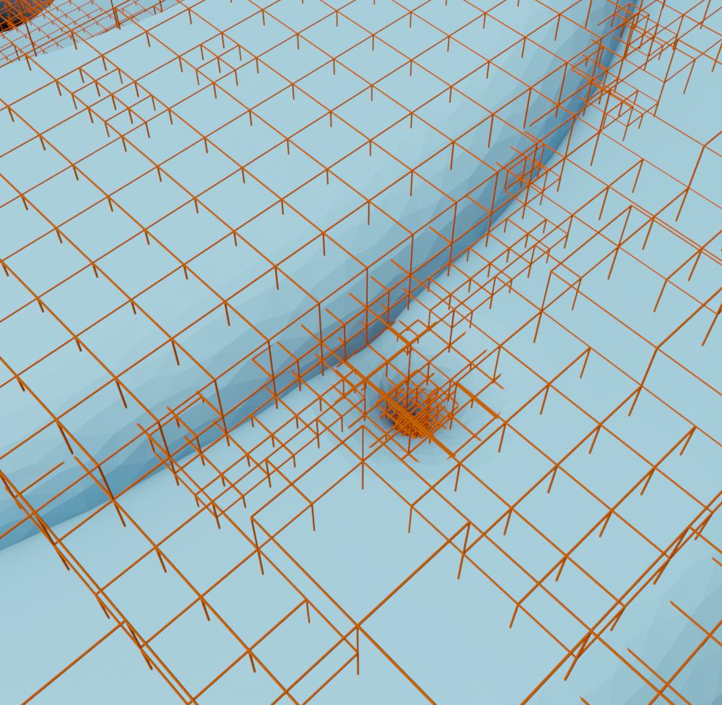
Dual Contouring – Octree Generation

Slide 15
Dual Contouring – Octree Generation
Do not refine a cell if:
The maximum level is reached
It does not contain the offset
The offset can be reconstructed with Dual Contouring

Slide 16
Dual Contouring – Octree Generation
Do not refine a cell if:
It does not contain the offset

Slide 17
Dual Contouring – Octree Generation
Do not refine a cell if:
It does not contain the offset

Slide 18
Dual Contouring – Octree Generation
Do not refine a cell if:
It does not contain the offset
The offset can be reconstructed with Dual Contouring

Slide 19
Dual Contouring – Octree Generation
Do not refine a cell if:
It does not contain the offset
The offset can be reconstructed with Dual Contouring

Slide 20
Dual Contouring – Octree Generation
Do not refine a cell if:
It does not contain the offset
The offset can be reconstructed with Dual Contouring

Slide 21
Dual Contouring – Octree Generation
Do not refine a cell if:
It does not contain the offset
The offset can be reconstructed with Dual Contouring

Slide 22
Dual Contouring – Octree Generation
Do not refine a cell if:
It does not contain the offset
The offset can be reconstructed with Dual Contouring

Slide 23
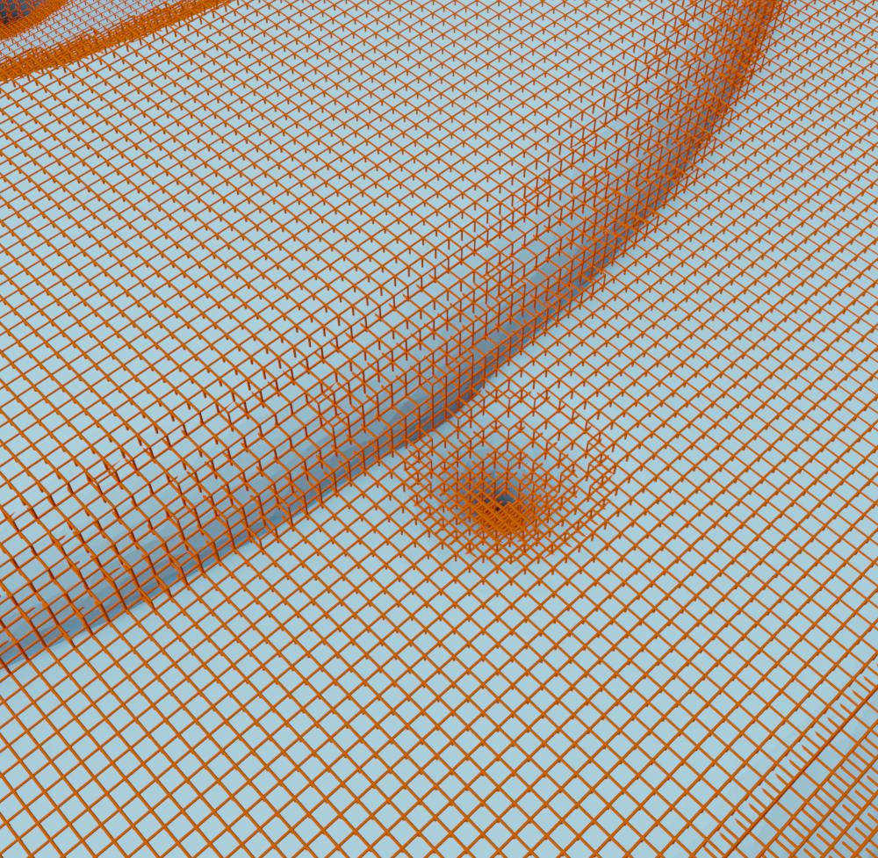
Dual Contouring – Octree Generation
#F: 45,392
#F: 523,784

Slide 24
Remeshing

Slide 25
Remeshing
split
collapse
flip
relocate

Slide 26
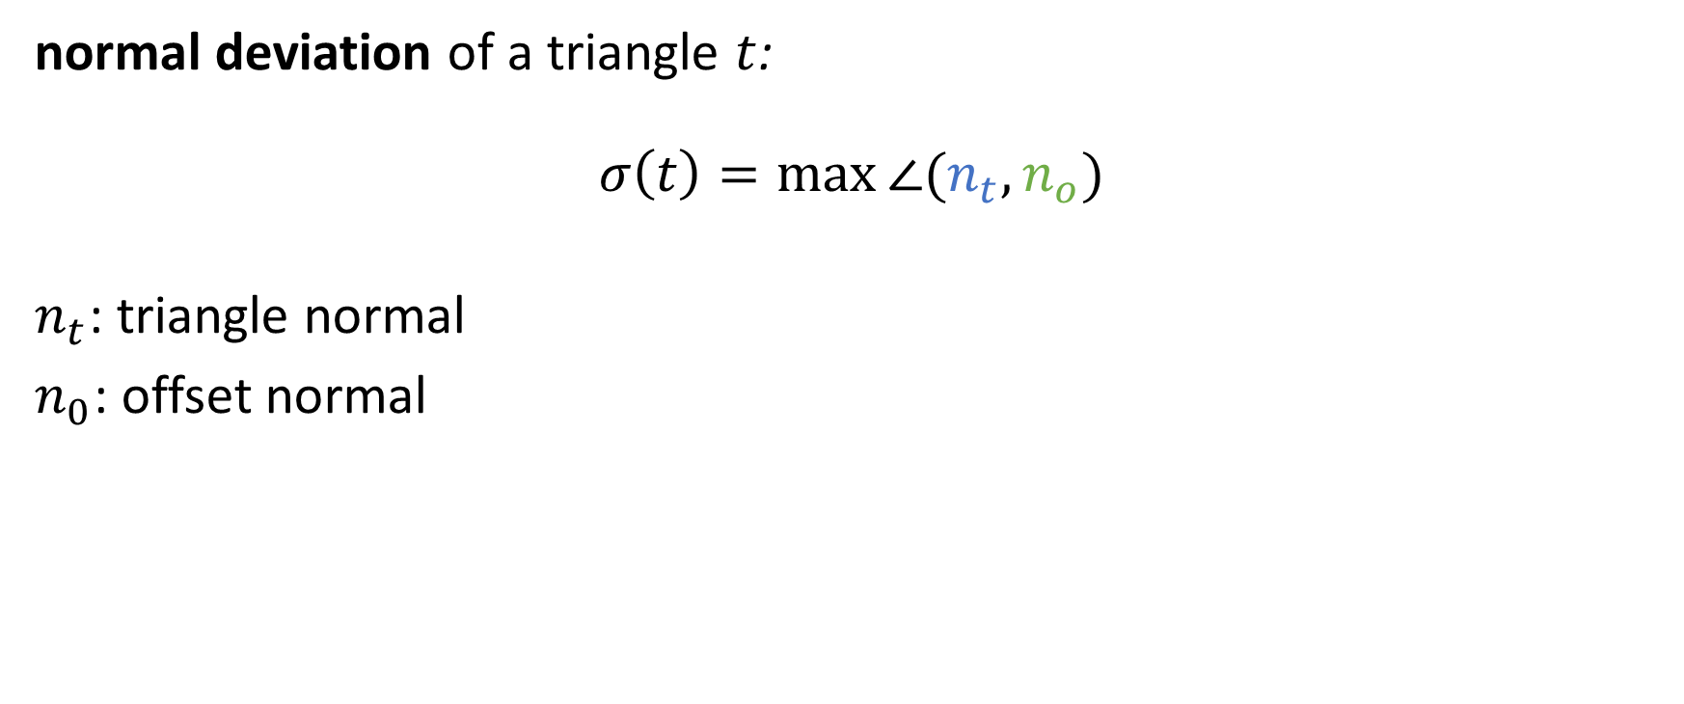
Remeshing
normal deviation of a triangle $t$:
$$σ\left(t\right)=\max{∠(n_{t},n_{o})}$$
$n_{t}$: triangle normal
$n_{0}$: offset normal

Slide 27
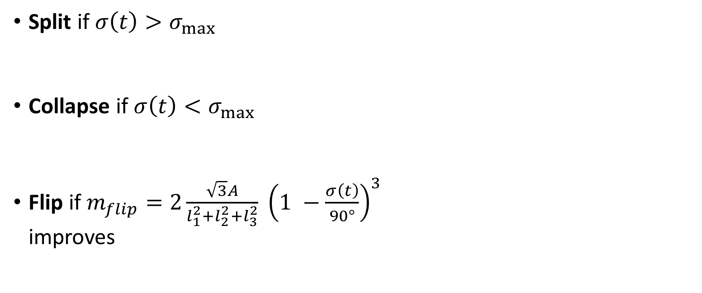
Remeshing
Split if $σ\left(t\right)>σ_{max}$
Collapse if $σ\left(t\right)<σ_{max}$
Flip if $m_{flip}=2\frac{\sqrt{3}A}{l_{1}^{2}+l_{2}^{2}+l_{3}^{2}} {\left(1 −\frac{σ\left(t\right)}{90°}\right)}^{3}$ improves
triangle shape
normal deviation

Slide 28
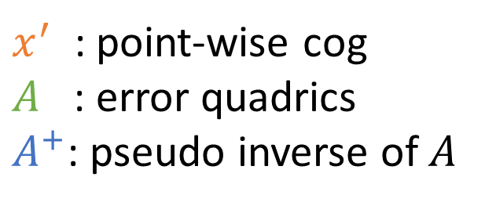
Remeshing
Relocate vertices
with error quadrics
$$x^{′′}=x^{′}+A^{+}(b −A x^{′})$$
$x^{′}$ : point-wise cog $A$ : error quadrics
$A^{+}$: pseudo inverse of $A$

Slide 29
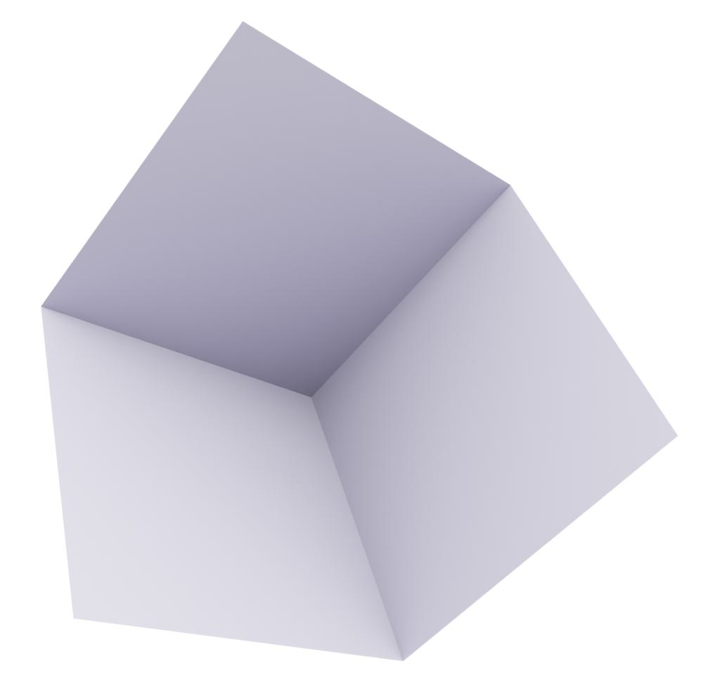
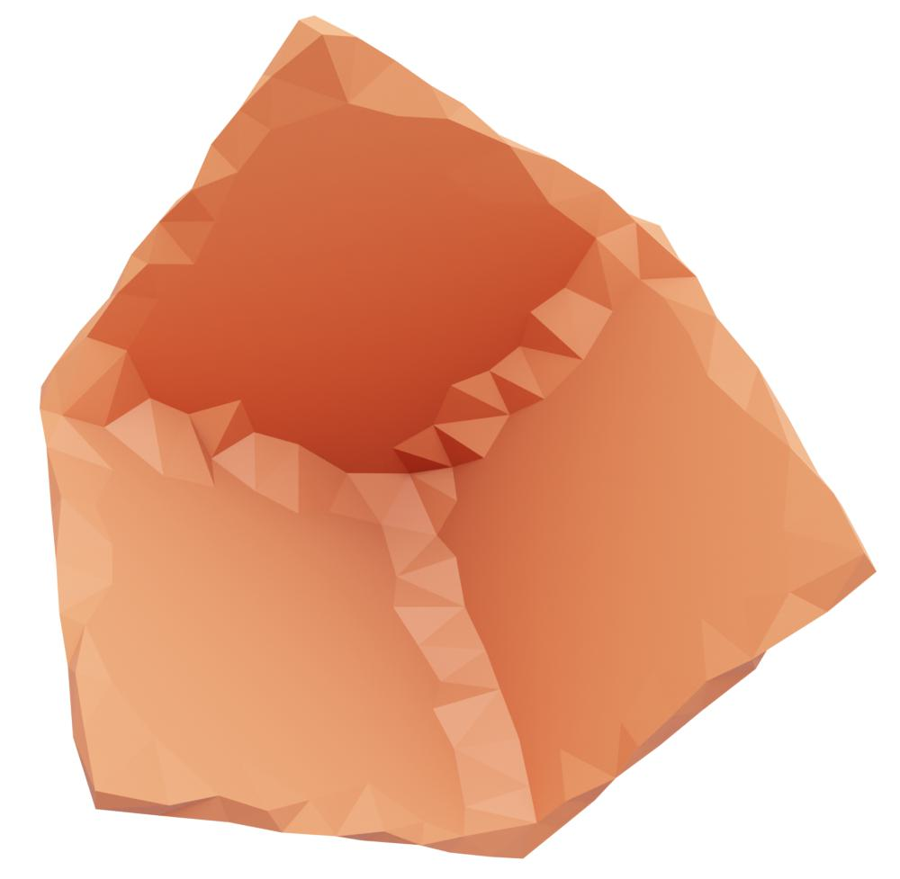
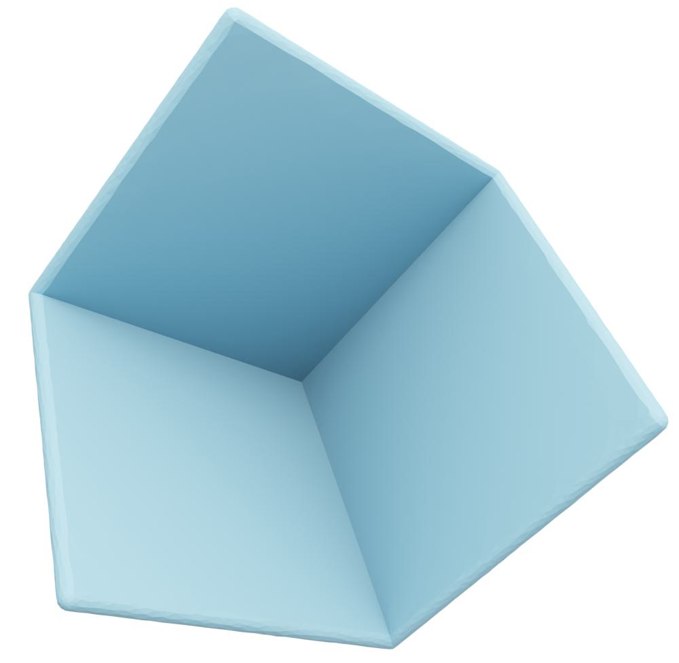
Results - Remeshing
input
alpha wrap
remeshing

Slide 30
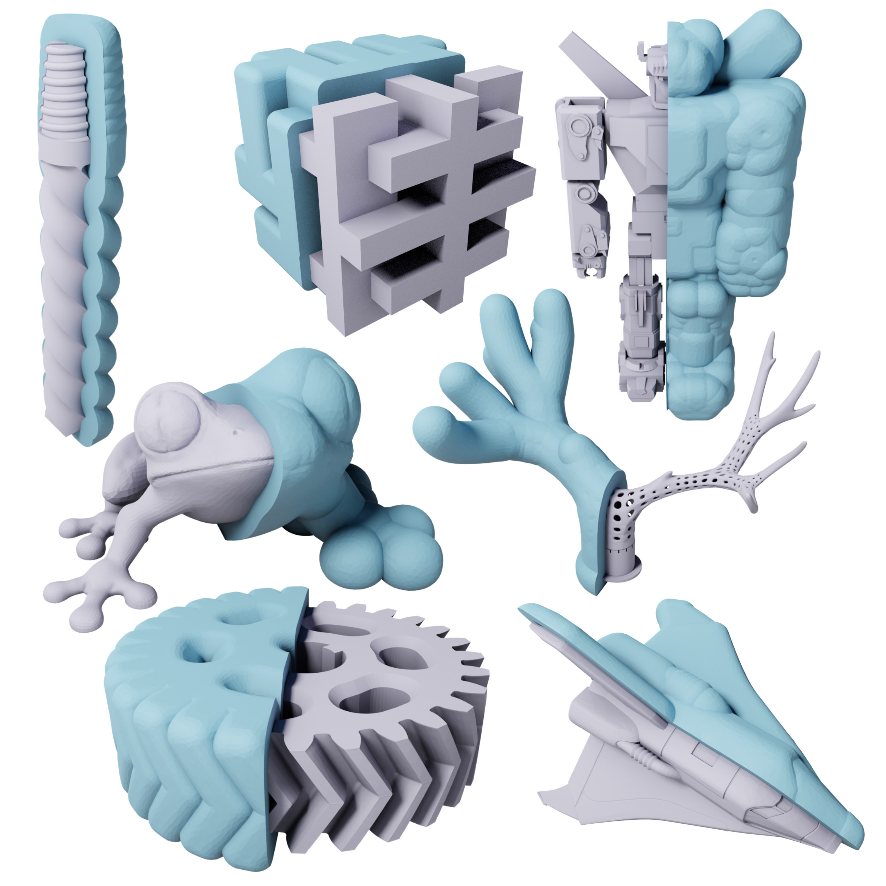
Results

Slide 31
Results
Tested on Thingi10k
For 10% offset (rel. to bbox), 70% of all meshes were computed in less than 1 minute
For 5% offset (rel. to bbox), 70% of all meshes were computed in less than 2 minutes

Slide 32
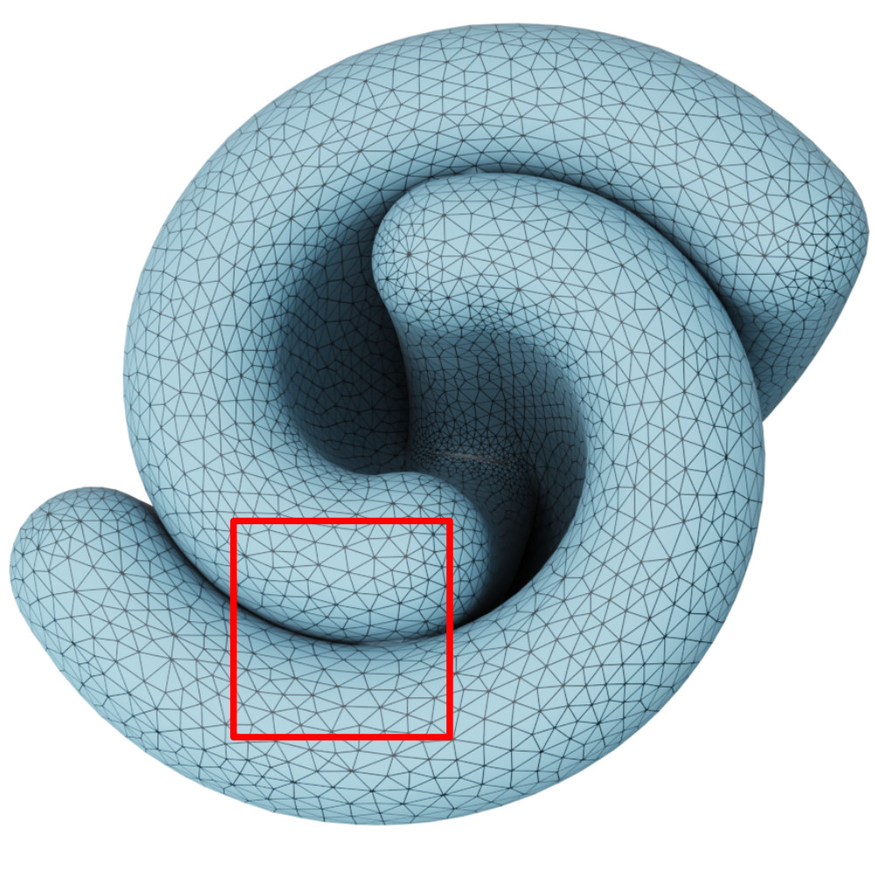
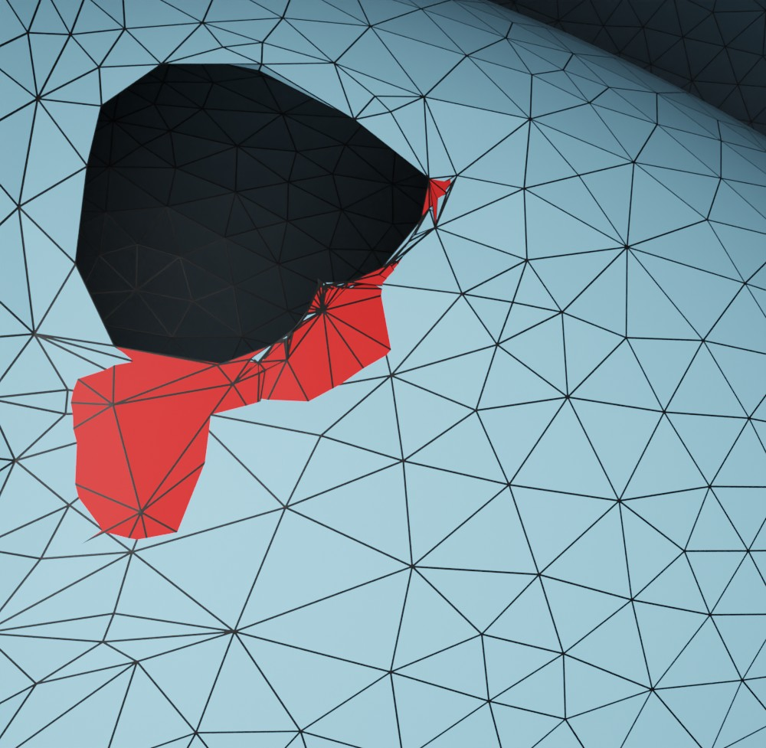
Limitations – Self-Intersections

Slide 33

Limitations – Self-Intersections
CGAL: remove_self_intersections()

Slide 34
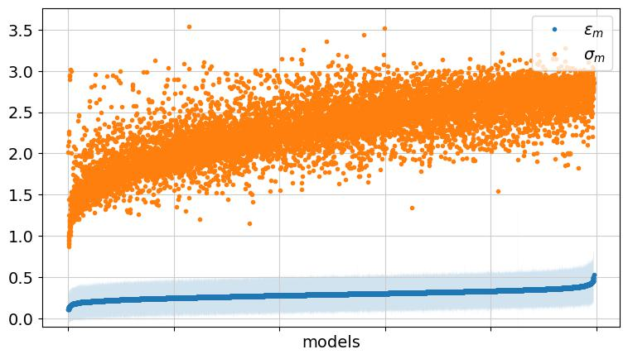
Thingi 10k – 10% offset
70% of all meshes were computed in less than 1 minute

Slide 35
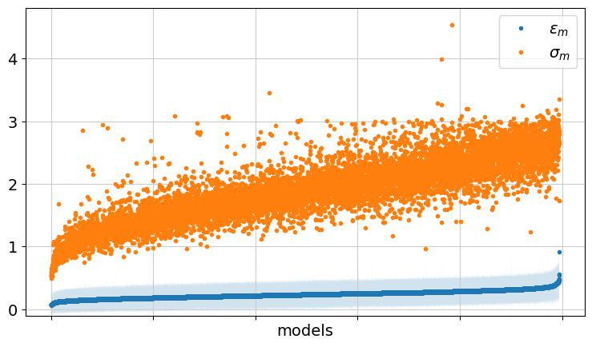
Thingi 10k – 5% offset
70% of all meshes were computed in less than 2 minutes

Slide 36
Thank you for your attention!

